Slide 1


183 DB Weekly Report
Week5 Team Parsley
Lin Li, Amir Omidfar, Wilson Chang, Angel Jimenez

Slide 2
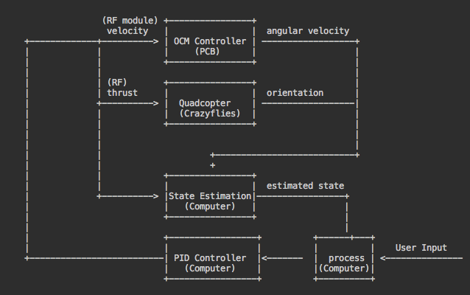
Controller Model

Slide 3
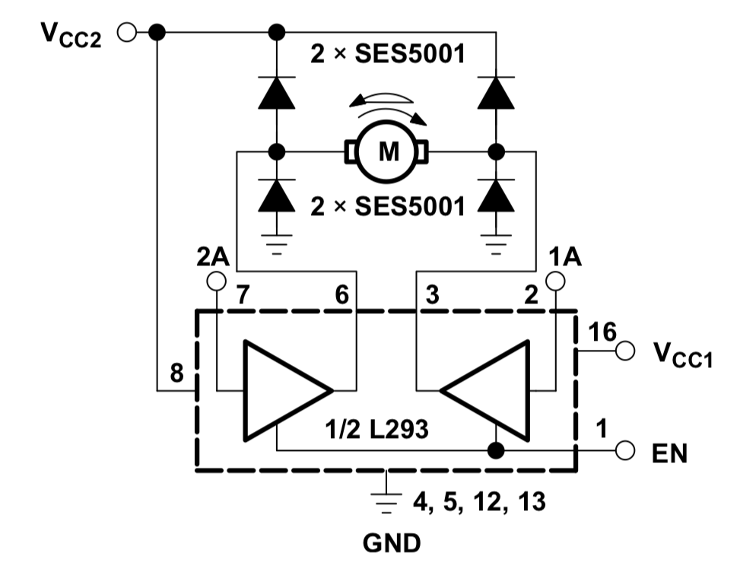
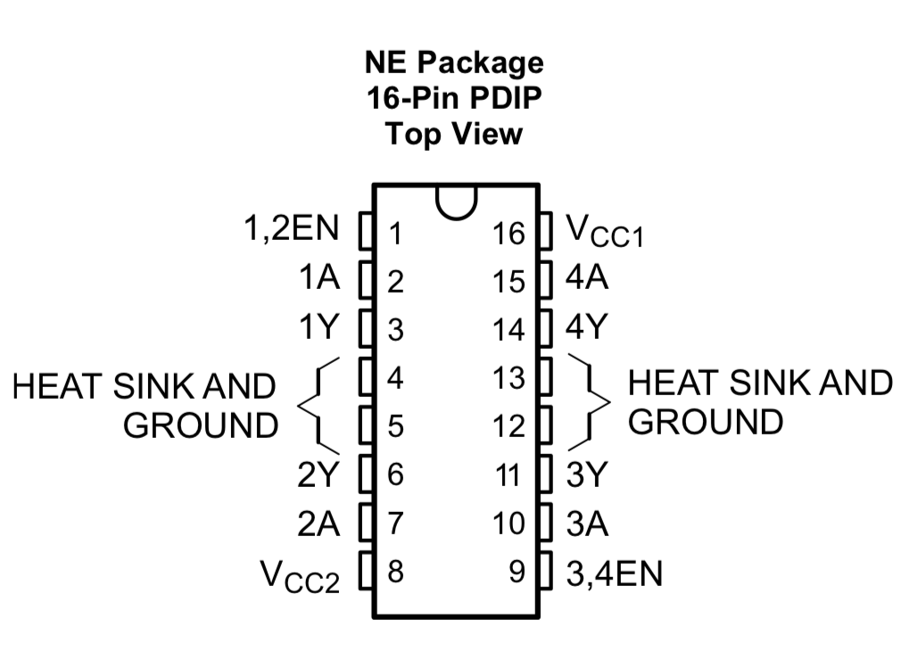
Off Center spinning mass module
Demo Link : https://youtu.be/nTm2-kypBXU

Slide 4
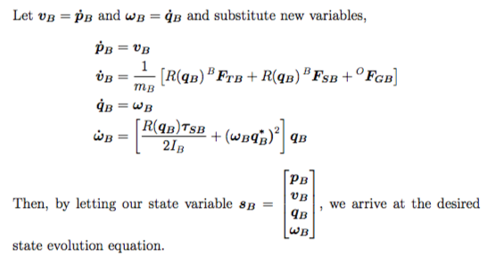
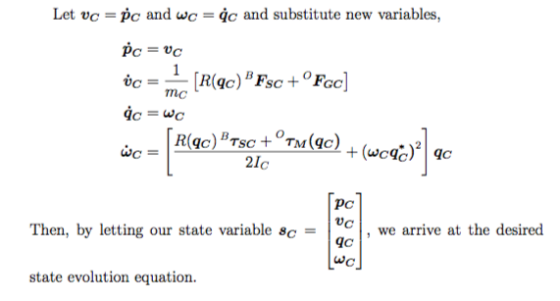
Documentation

Slide 5
Next Week Planning
Implement the sensor fusion
Improve the controller model based on data collected and simulation data

Slide 6
References
L293D (H-bridge) Datasheet :
http://www.ti.com/lit/ds/symlink/l293d.pdf

